Slide 1
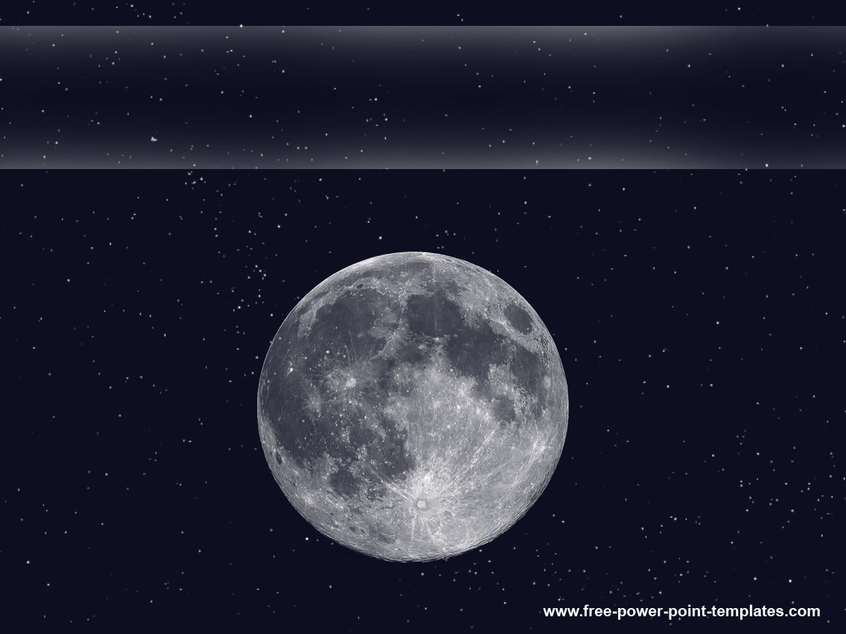

Lunar Lander
Georgia Institute of Technology
CS 7642 – Reinforcement Learning
Summer 2017
James Chan
Source code sharing subject to Georgia Tech Honor Code restriction.
Available for private viewing upon request.
Lunar Lander is intellectual property of OpenAI

